Slide 1

Automotive Data Analysis Project
By Abdellah Boudal
Course: 44-413, 613 Data Visualization
February 2026
This project analyzes car sales and vehicle specs to reveal how price, horsepower, and fuel efficiency influence market performance using Excel visualizations.

Slide 2
Introduction
This project analyzes car sales performance and vehicle specifications using an Excel dataset. The goal of this analysis is to explore how vehicle characteristics such as price, horsepower, and fuel efficiency influence sales and market performance. Data visualization techniques were used to transform raw data into meaningful insights that can support business and marketing decisions in the automotive industry.
Data Source:
https://github.com/Sonya-7/Car\_Sales\_Dashboard/blob/main/Car\_Sales.xlsx

Slide 3
Data Description
The dataset belongs to the automotive sales domain and contains detailed information about car manufacturers and models. The analysis focuses on how different membership types perform across several months using Excel visualizations. The data file includes sales performance, pricing, resale value, retention rates, engine specifications, and physical vehicle attributes.
Describe your data source:
The data source was obtained from GitHub and is publicly available for analytics and visualization practice.
Number of data columns:
19 columns
Number of data records:
155 records
Data Features Summary
Column Name
Description
Manufacturer
Car brand name
Model
Car model
Unit Sales
Units sold
Price ($)
Sale price
Year Resale Value ($)
Resale price
Retention %
Value retention
Engine Size
Engine capacity
Horsepower
Engine power
Vehicle Type
Car category
Fuel Efficiency (MPG)
Fuel economy
Curb Weight
Vehicle weight

Slide 4
Data Cleaning Strategies
Although the dataset was already structured, several cleaning and preparation steps were applied to improve clarity and focus on the project goals. The following columns were removed because they were not relevant to the selected business objectives:
Power Performance Factor
Wheelbase
Width
Length
Curb Weight
Fuel Capacity
Latest Launch
These attributes were more technical specifications and were not necessary for sales, pricing, fuel efficiency, or retention analysis.
Additionally:
Currency fields (Price, Year Resale Value) were formatted properly.
Retention percentages were standardized.
Horsepower was grouped into categories (Low, Medium, High).
Retention was classified as GOOD or POOR.
These steps ensured a focused and efficient dataset for pivot table analysis and visualization.

Slide 5
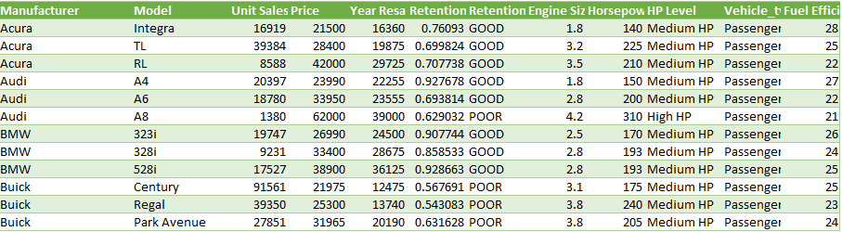
Clean Dataset Overview
The cleaned dataset contains 155 rows and 12 attributes ready for visualization. An excerpt of the dataset includes:
Manufacturer: Acura, Audi, BMW...
Price range: $9,235 – $85,500
Sales range: 110 – 540,561 units
Fuel efficiency: 15 – 45 MPG
This dataset allows analysis of relationships between vehicle performance and market success.

Slide 6
Visualization Tools
For this project, Microsoft Excel was selected as the primary data visualization and analysis tool. Excel was chosen due to its strong capabilities in data aggregation, pivot table analysis, and chart visualization. It provides an efficient environment to clean, transform, and analyze structured datasets such as automotive sales data.
Several Excel features were utilized throughout the project, including:
Pivot Tables for data aggregation and grouping
Calculated averages and maximum values
Sorting and Top N filtering
Classification grouping (Retention categories, HP levels)
Data formatting (currency, percentages)
Chart creation and customization
Multiple chart types were created to match the analytical goals, including:
Bar charts
Column charts
Pie charts
Excel was particularly effective for comparing manufacturer sales performance, analyzing pricing structures, and evaluating resale value retention.
All visualizations and dashboards were created and organized within a single Excel workbook to ensure consistency and clarity.
GitHub Data Source:
https://github.com/Sonya-7/Car\_Sales\_Dashboard/blob/main/Car\_Sales.xlsx

Slide 7
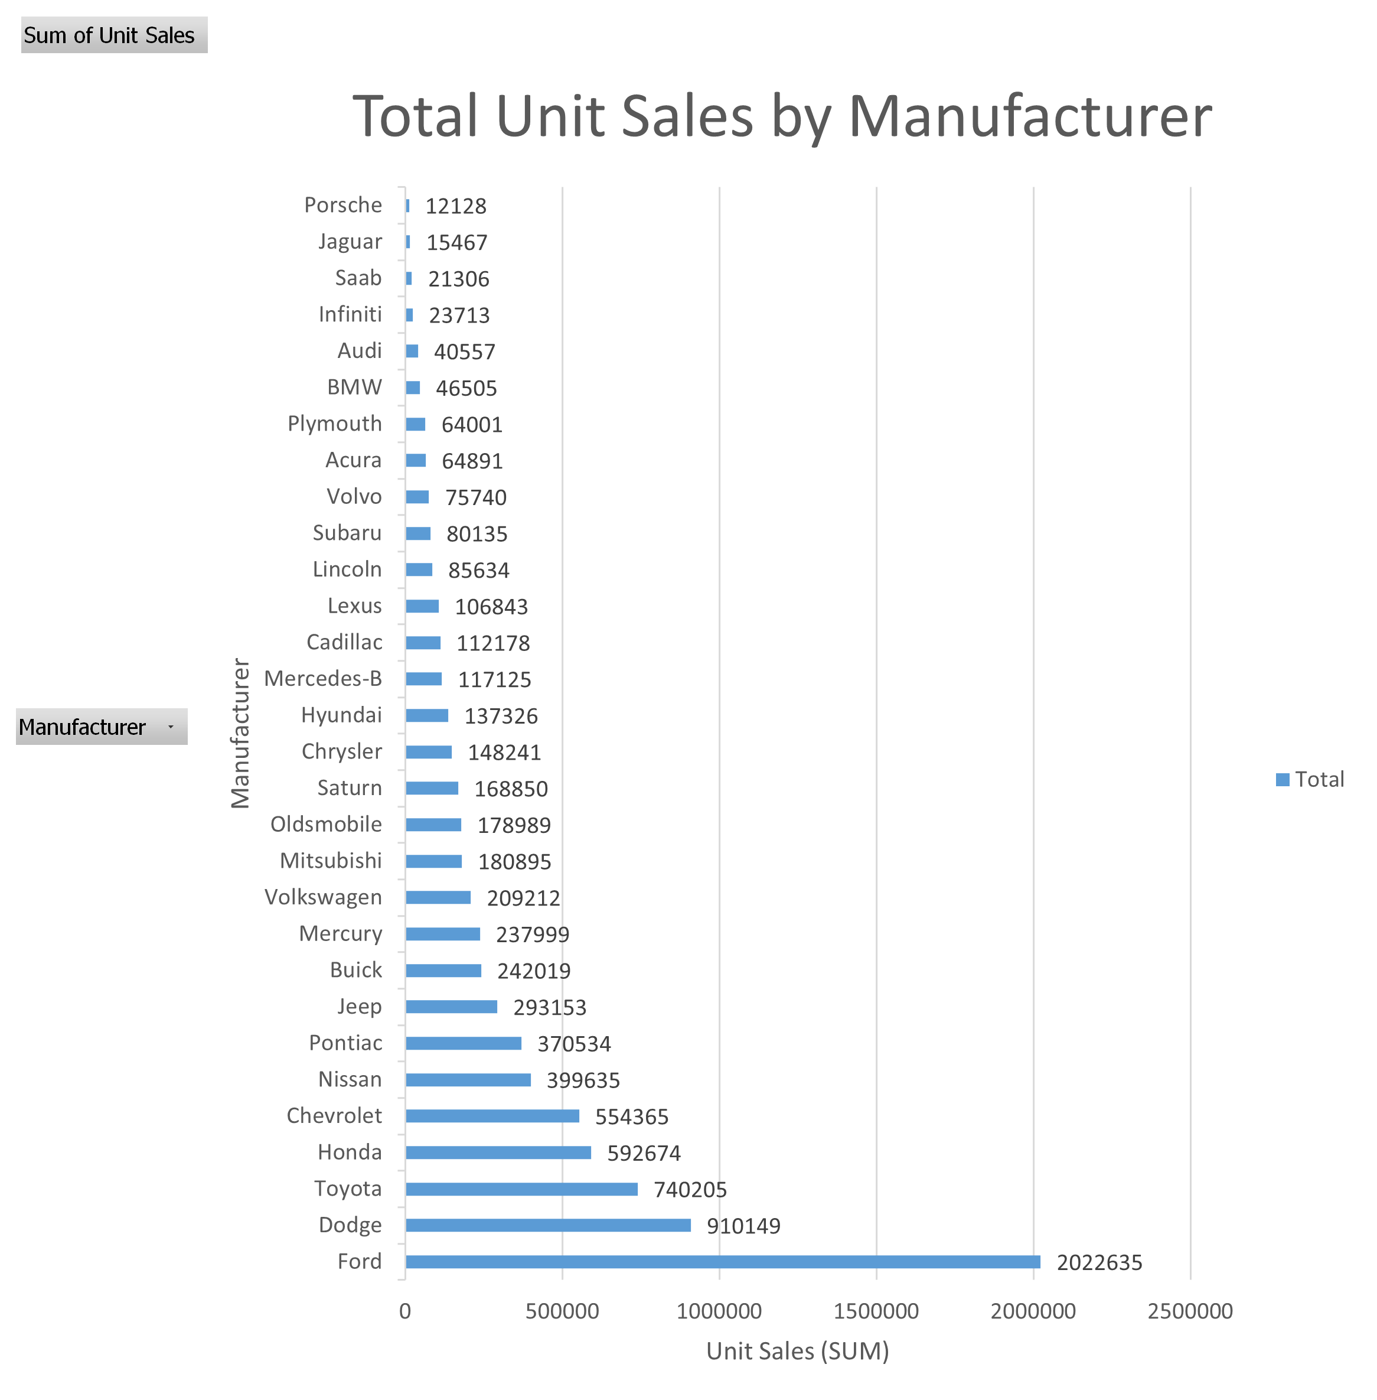
Visualizations & Stories
Goal 1: Total Unit Sales by Manufacturer
Story / Analysis
Prepared by Abdellah Boudlal
This visualization presents the total unit sales for each car manufacturer included in the dataset.
The analysis reveals that Ford has the highest total unit sales, significantly exceeding all other manufacturers.
This indicates strong brand demand and a dominant market presence.
Dodge and Toyota also rank among the top manufacturers in sales volume, showing consistent performance and wide consumer reach.
On the other hand, luxury manufacturers such as Porsche and Jaguar record much lower unit sales.
This difference is expected because luxury vehicles are sold in smaller quantities due to higher pricing and niche market targeting.

Slide 8
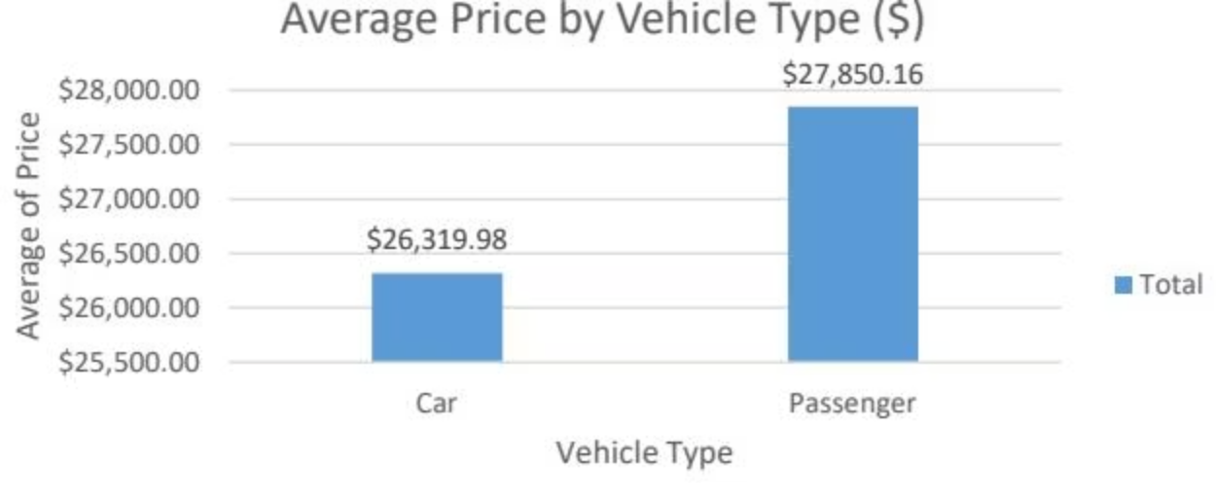
Average Price by Vehicle Type
Goal 2: Average Price by Vehicle Type
Prepared by Abdellah Boudlal
Story / Analysis
This visualization compares the average selling price between Passenger vehicles and Cars.
The analysis shows that Passenger vehicles have a slightly higher average price ($27,850) compared to Cars ($26,319).
This difference may be explained by the presence of premium sedans and luxury passenger models in the dataset,
which increase the overall average price.
Cars such as SUVs and utility vehicles tend to serve broader markets, often balancing price with functionality and affordability.
Key Insight
Vehicle type influences pricing structure, with passenger vehicles showing marginally higher average market value.

Slide 9
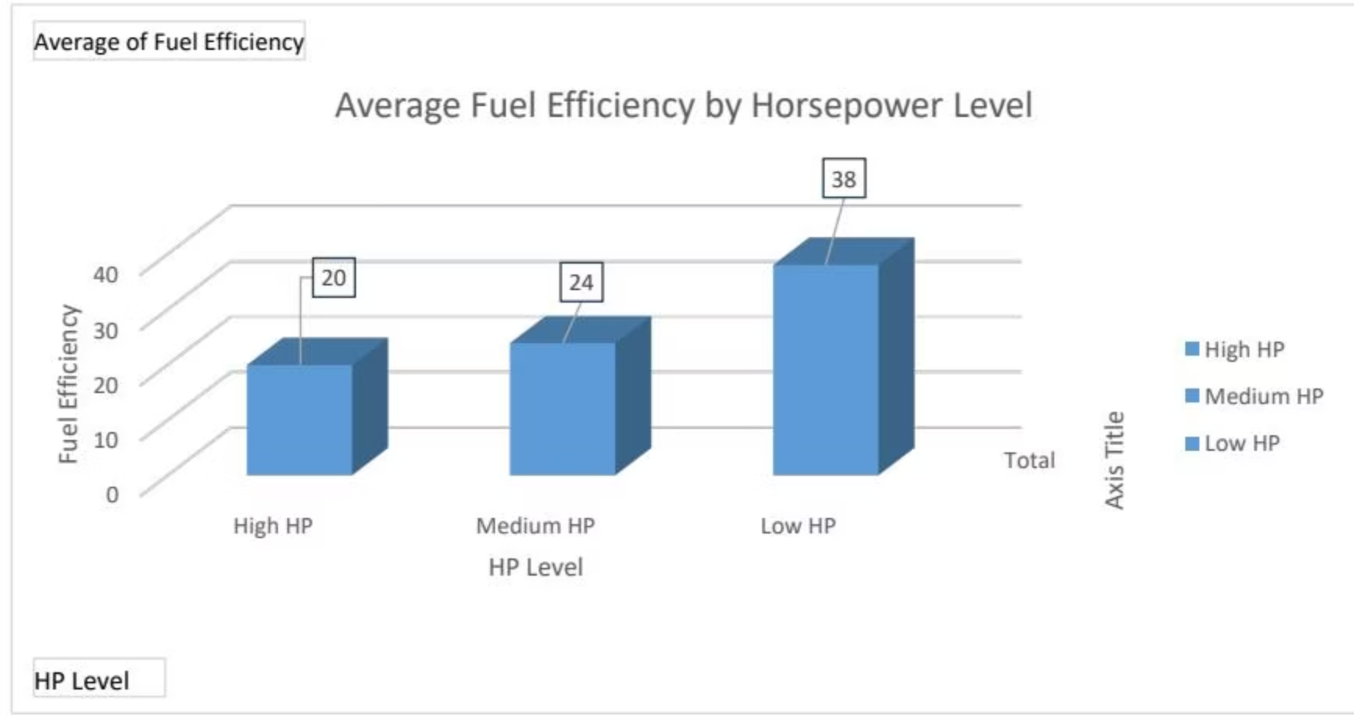
Fuel Efficiency by HP Level
Goal 3: Fuel Efficiency by HP Level
Story / Analysis
Prepared by Abdellah Boudlal
This visualization examines how fuel efficiency varies across different horsepower levels.
The analysis shows that:
Low HP vehicles have the highest fuel efficiency (38 MPG).
Medium HP vehicles average around 24 MPG.
High HP vehicles have the lowest fuel efficiency (20 MPG).
This demonstrates a clear inverse relationship between horsepower and fuel efficiency. As engine power increases, fuel consumption
also increases, resulting in lower MPG values.
This pattern reflects real-world automotive design, where high-performance vehicles prioritize speed and power over fuel economy.

Slide 10
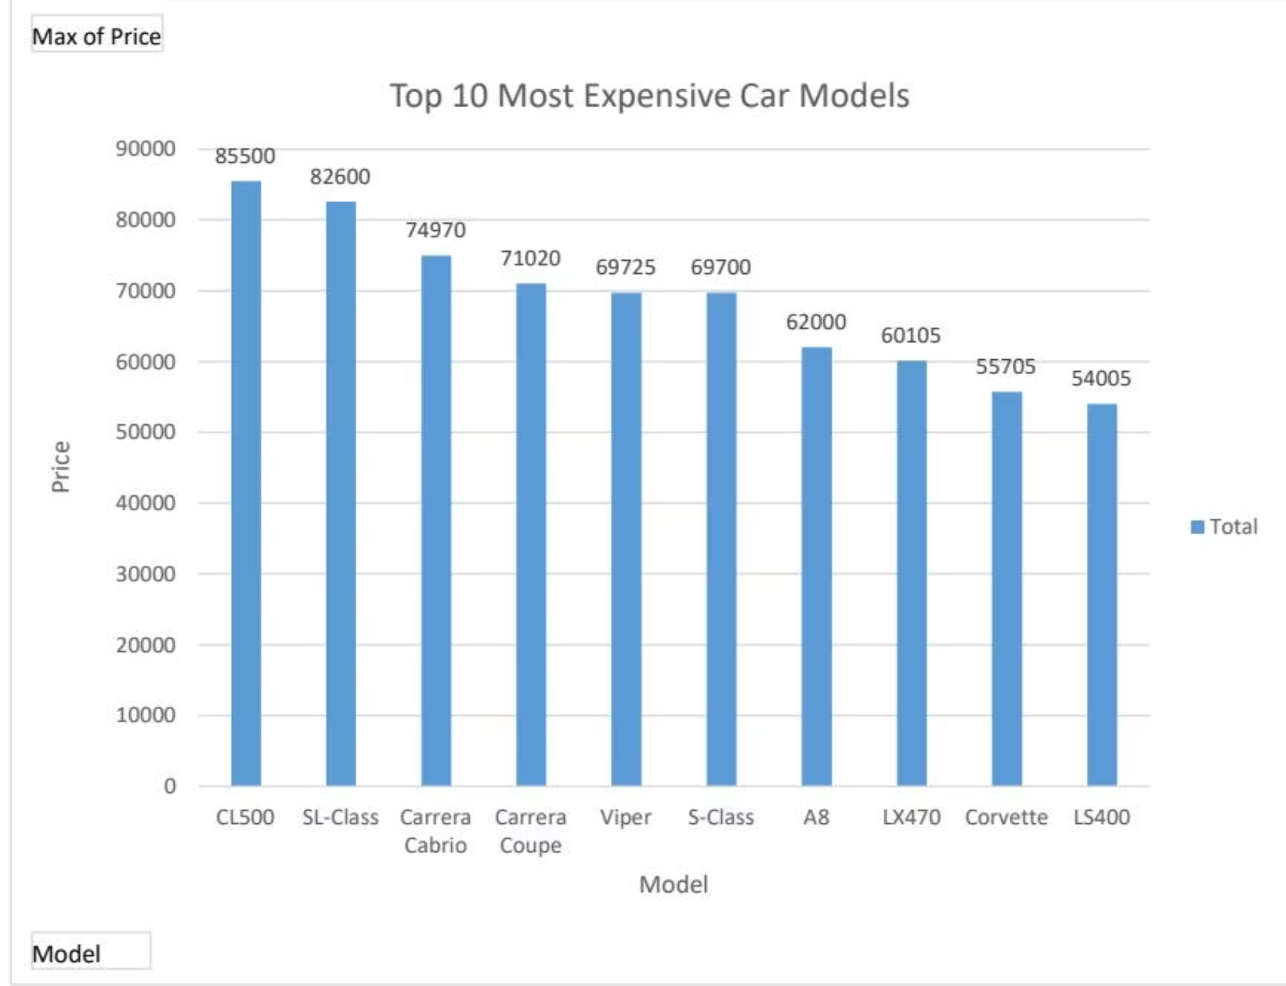
Most Expensive Models
Goal 4: Most Expensive Models
Story / Analysis
Prepared by Abdellah Boudlal
This visualization highlights the highest-priced vehicles within the dataset.
The analysis reveals that luxury and performance brands dominate the top price rankings.
The most expensive model identified is the Mercedes-Benz CL500, with a price exceeding $85,000.
Other high-ranking models include:
Mercedes-Benz S-Class
Porsche Carrera Cabrio
Porsche Carrera Coupe
Dodge Viper
These vehicles are characterized by high horsepower engines, premium materials, and luxury features, which significantly increase
their market price.
The chart demonstrates how luxury automotive brands position themselves in the high-end pricing segment.
Key Insight
Luxury and performance vehicles command significantly higher prices, reflecting brand value, engineering complexity, and premium market positioning.

Slide 11
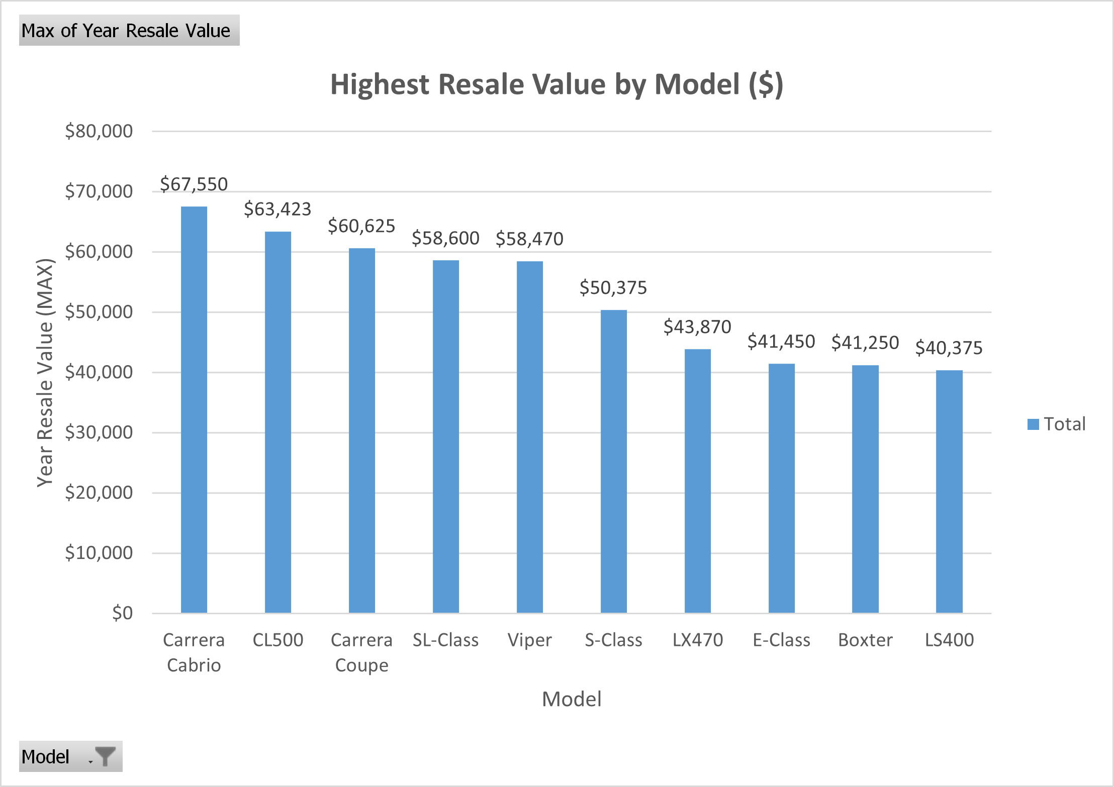
Fuel Efficiency by HP Level
Goal 5: Highest Resale Value
Story / Analysis
Prepared by Abdellah Boudlal
This visualization highlights the vehicle models that maintain the strongest resale value over time.
The analysis reveals that premium and luxury sports vehicles dominate the top resale rankings.
The model with the highest resale value is the Porsche Carrera Cabrio, exceeding $67,000.
Other top performers include:
Mercedes-Benz CL500
Porsche Carrera Coupe
Mercedes-Benz SL-Class
Dodge Viper
These vehicles maintain strong resale value due to high brand prestige, superior engineering quality, and sustained market demand.
Luxury and performance vehicles depreciate at a slower rate compared to standard passenger vehicles.

Slide 12
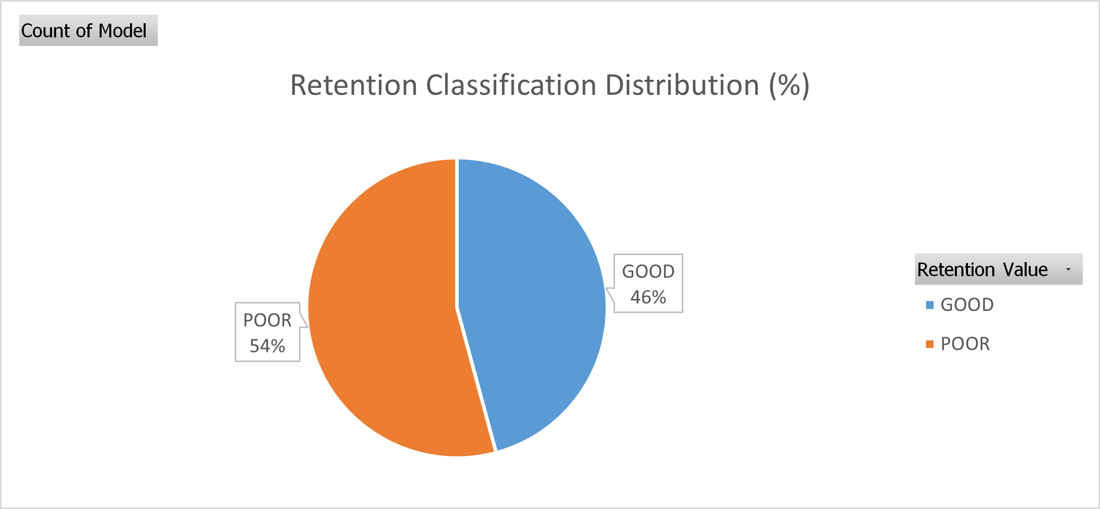
Average Price by Vehicle Type
GOAL 6 — Retention Distribution
Prepared by Abdellah Boudlal
Story / Analysis
This visualization illustrates the distribution of vehicle retention performance across the dataset.
The analysis shows that:
54% of vehicles fall under the POOR retention category.
46% of vehicles are classified as GOOD retention.
This indicates that the majority of vehicles depreciate at a faster rate, losing a significant portion of their resale value over time.
However, a substantial segment of vehicles maintains strong value retention, typically associated with premium brands and
higher-quality engineering.
Key Insight
Vehicle depreciation is prevalent across the dataset, with more than half of models experiencing weaker resale retention.

Slide 13
Conclusion
This project explored automotive sales and vehicle performance data through multiple visualization perspectives. Key findings include:
Certain manufacturers dominate total unit sales, reflecting strong brand market share.
Passenger vehicles show slightly higher average pricing compared to general vehicle categories.
Fuel efficiency decreases as horsepower increases, demonstrating the trade-off between performance and economy.
Luxury and performance models rank highest in both initial price and resale value.
Premium brands maintain stronger long-term value retention.
More than half of vehicles fall into the poor retention category, highlighting industry-wide depreciation trends.
Overall, the analysis demonstrates how data visualization can transform complex automotive datasets into actionable insights.
These findings could support manufacturers, dealerships, and investors in pricing strategy, product positioning, and long-term asset valuation decisions.

